Slide 1
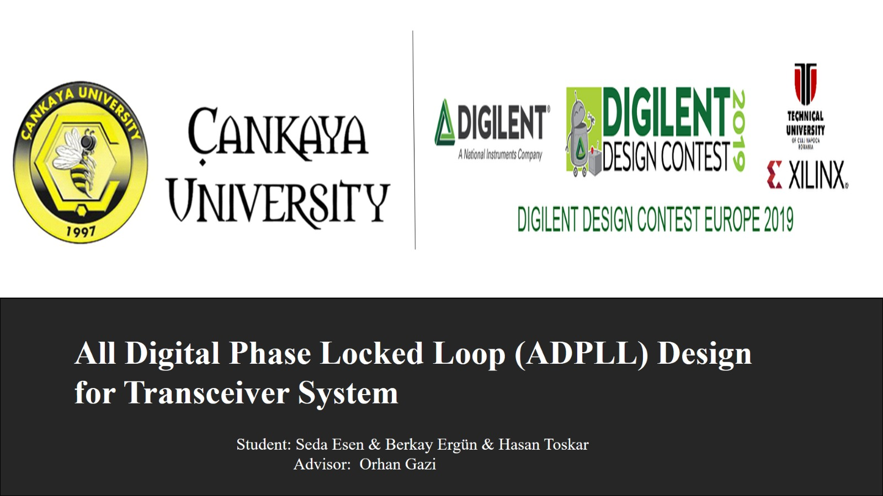

Slide 2
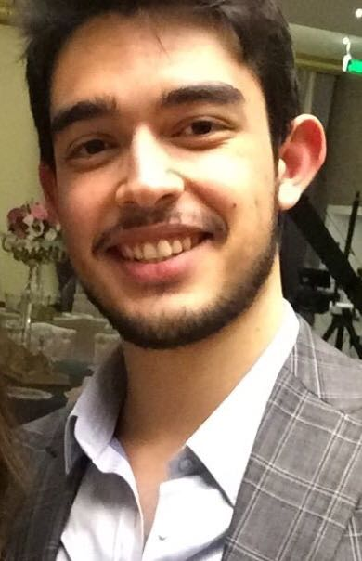
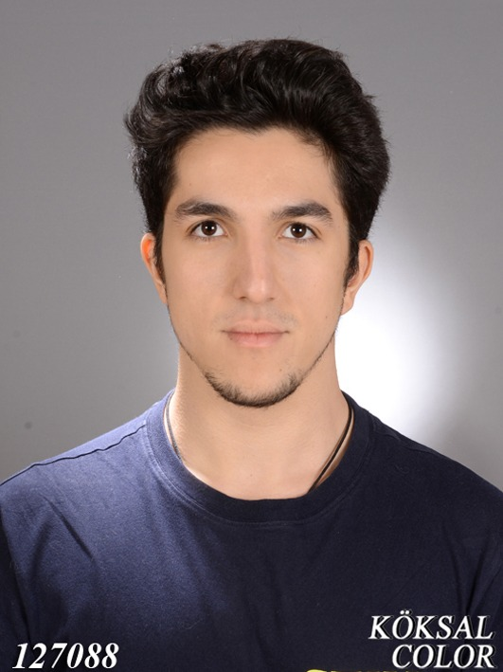
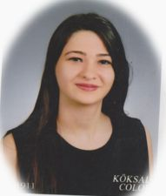
Berkay Ergün
Hasan Toskar
Seda Esen

Slide 3
Outline
All Digital Smart System
Why we choose FPGA ?
The “ADPLL System for Transceiver” Project
Transmitter
Receiver
Conclusion
References

Slide 4
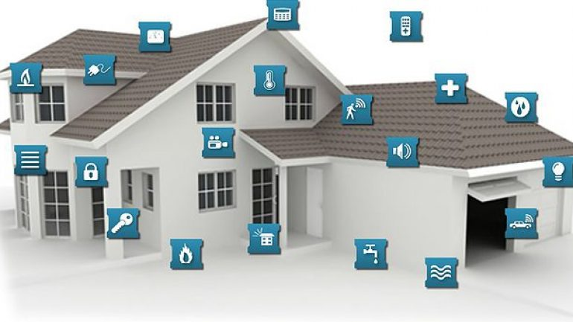
All Digital Smart System
Are you sure your smart systems are enough ?
The number of smart homes in America reached 24.6 million in 2019.
Figure.1

Slide 5
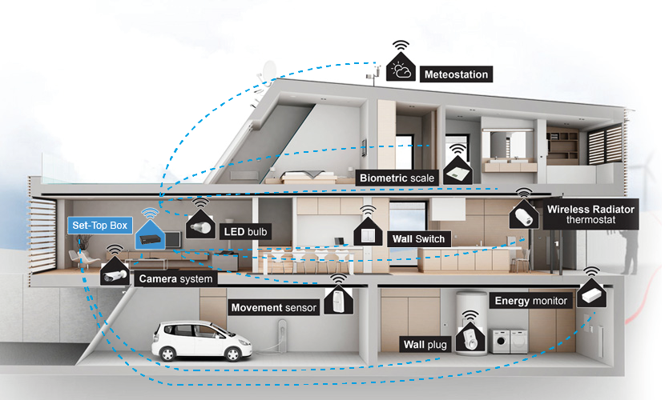
All Digital Smart System
Smart home systems are evolving day by day.
But can we keep up?
Smart home systems are a lot of sensors and sub-systems.
To manage all of these systems, we need a resource that works fast and parallel.
Figure.2

Slide 6
Why we choose FPGA ?
Latest families of FPGA are both powerful and cheap. But are they suitable for smart home systems ?
The main advantage is that the architecture is easily reconfigurable and parallel processing.
FPGAs have started to offer most of what expensive chips do:
high speed circuits,
large memory blocks,
multipliers, etc.

Slide 7
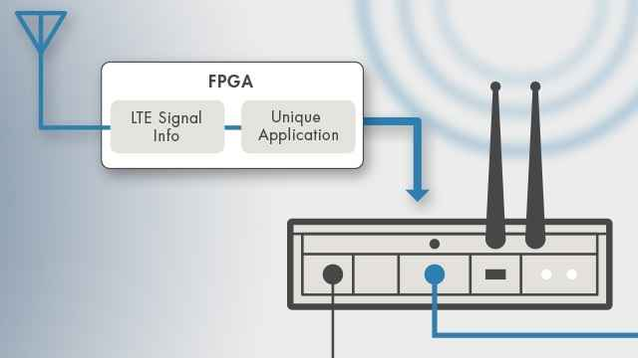
The “ADPLL System for Transceiver” Project
FPGA based Transceiver system that used QAM.
ADPLL based receiving algorihtm.
Figure.3

Slide 8
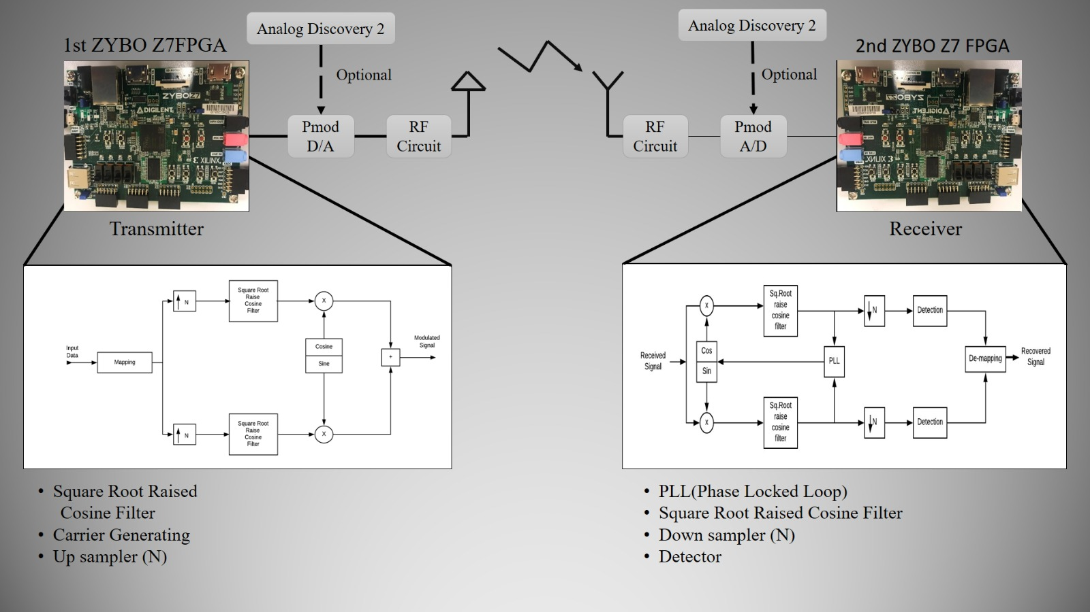
Transceiver Block Diagrams

Slide 9
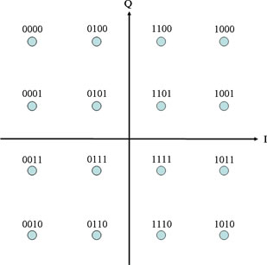
QAM
QAM(Quadrature Amplitude Modulation) used for fast and reliable communication systems.
In QAM design we have 2 constant whether they multiply with sine or cosine and then send to the communication channel
Figure.5

Slide 10
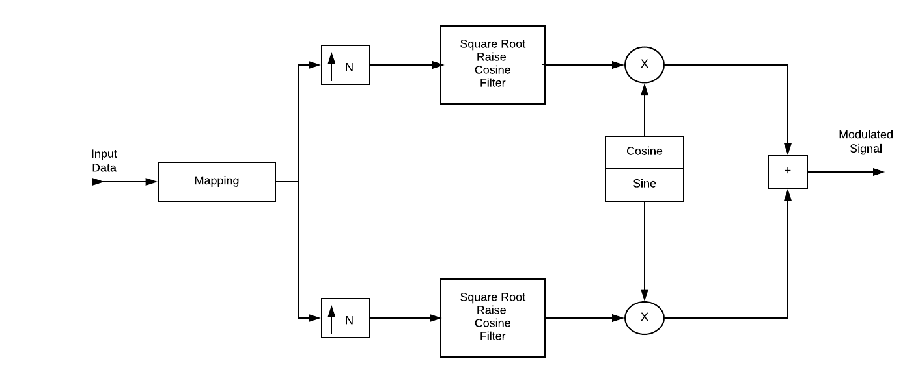
Transmitter Block Diagram
Figure.6

Slide 11
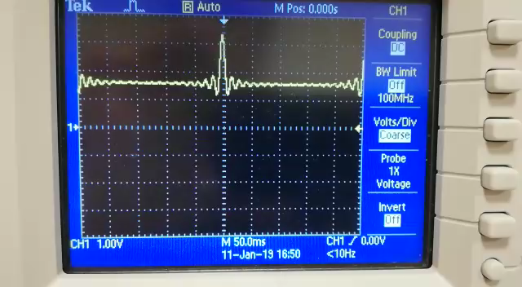
SRRC
SSRC is often used as a transmit and receive filter in a digital communication system to perform a matching filtering. This helps minimize inter-symbol interference (ISI).
Figure.7:FPGA Output S.R.R.C. Filter

Slide 12
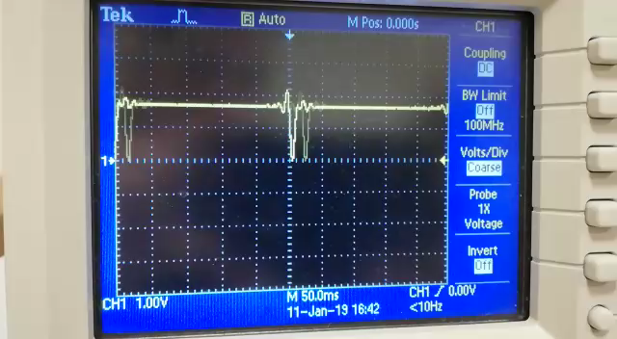
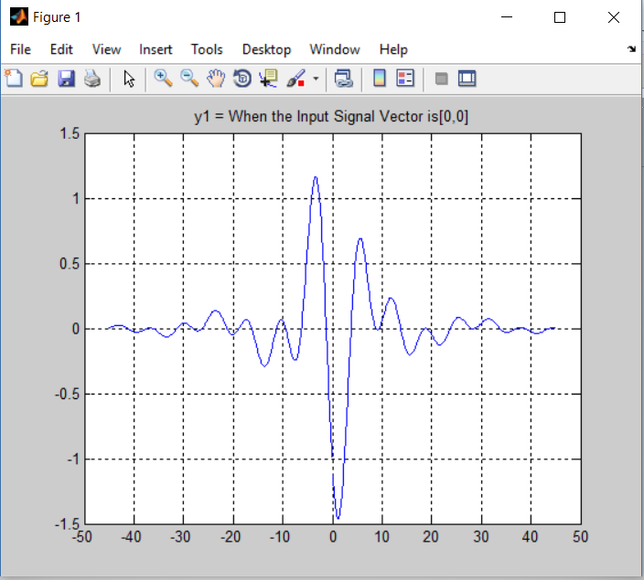
1st Condition ( input = [0,0] )
Figure.8:FPGA Output of 1st Condition
Figure.9:MATLAB Simulation of 1st Condition

Slide 13
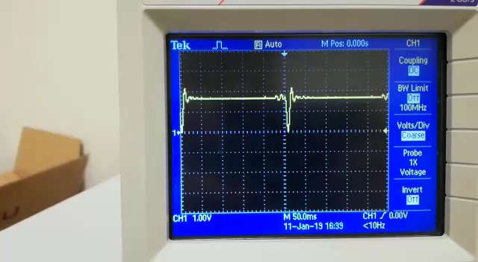
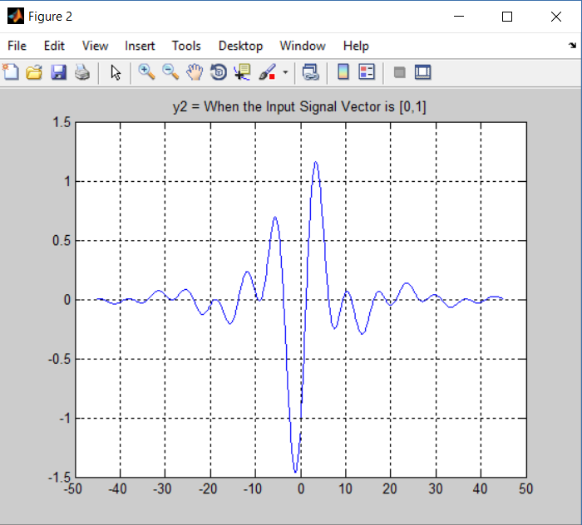
2nd Condition ( input = [0,1] )
Figure.10:FPGA Output of 2nd Condition
Figure.11:MATLAB Simulation of 2nd Condition

Slide 14
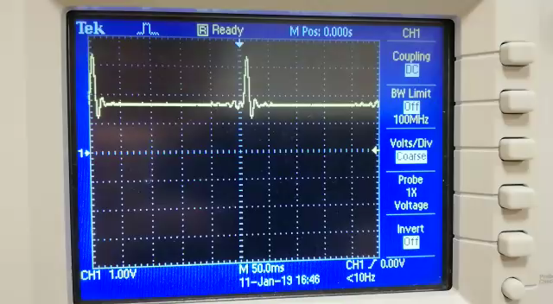
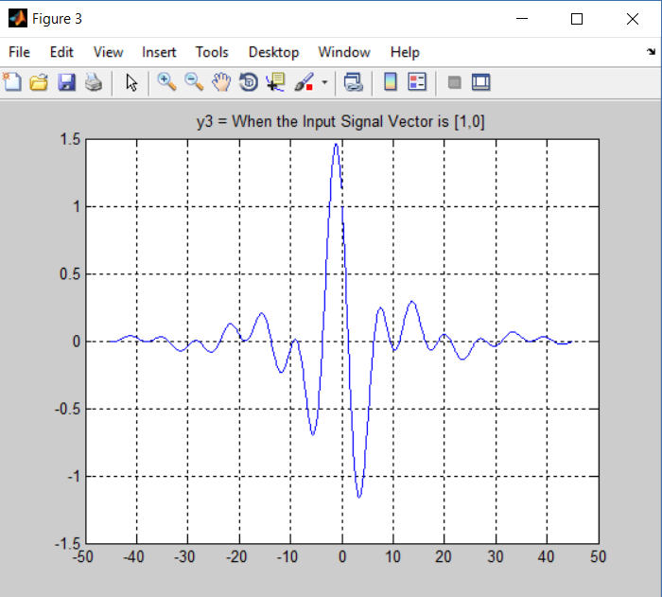
3rd Condition ( input = [1,0] )
Figure.12:FPGA Output of 3rd Condition
Figure.13:MATLAB Simulation of 3rd Condition

Slide 15
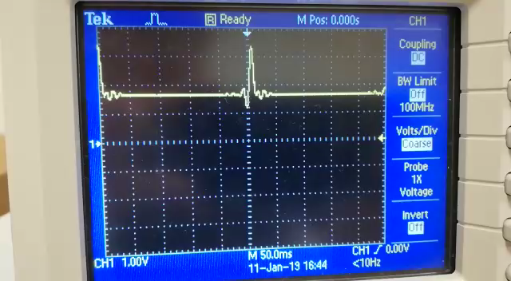
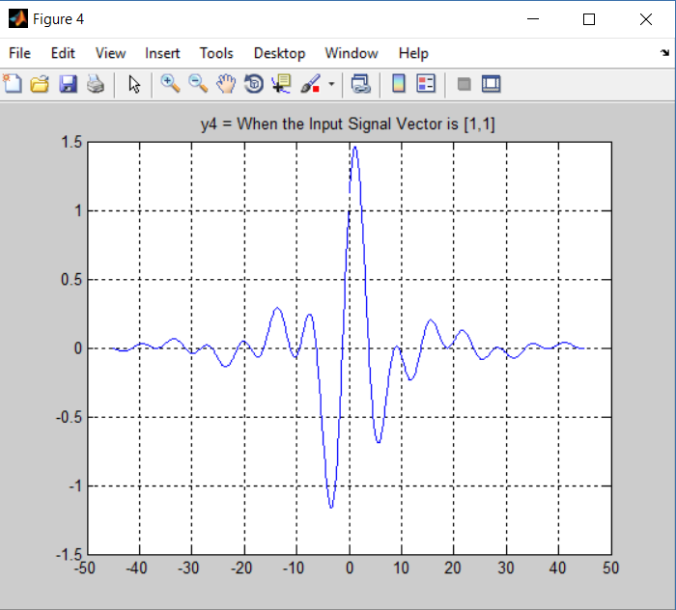
4th Condition ( input = [1,1] )
Figure.14:FPGA Output of 4th Condition
Figure.15:MATLAB Simulation of 4th Condition

Slide 16
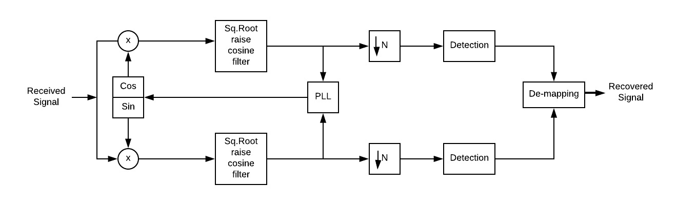
Receiver Block Diagram
Figure.16

Slide 17
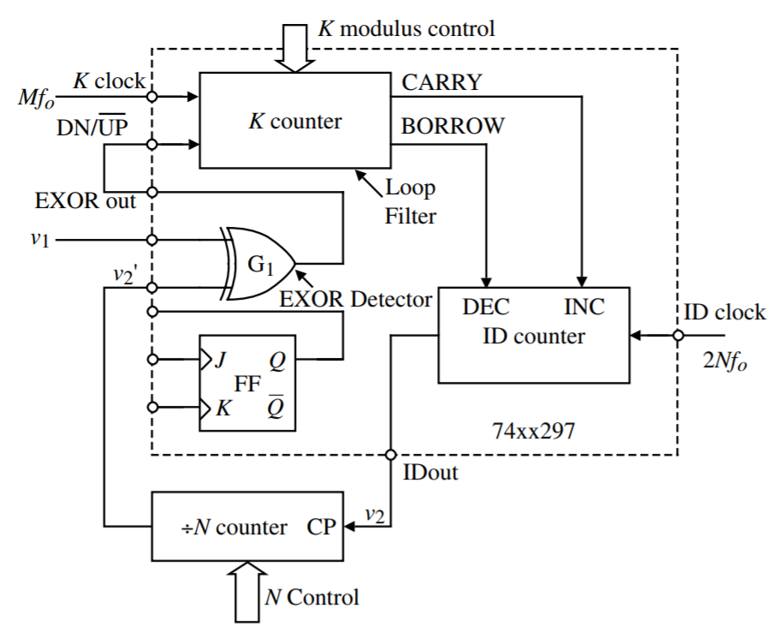
Phase Locked Loop (PLL)
A phase-locked loop or phase lock loop (PLL) is a control system that generates an output signal whose phase is related to the phase of an input signal.
Figure.17

Slide 18
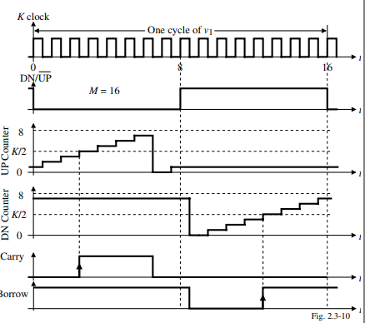
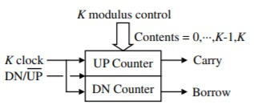
K Counter
Both counters count upwards.
Carry = 1 when contents of the
UP counter ≥ K/2.
Borrow = 1 when contents of the
DN counter ≥ K/2
Figure.18
Figure.19

Slide 19
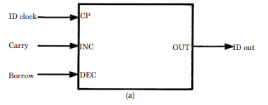
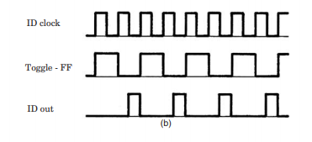
ID Counter
Figure.20
The ID counter processes the carrier and borrow signals from the K counter.
Figure.21
ID out= (not(id clock) and (not toggle FF))

Slide 20
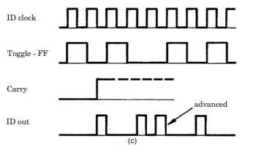
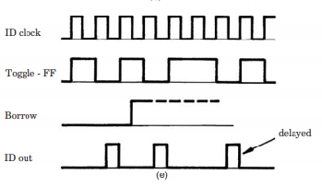
Carry
Borrow
If there is a carrier signal in the circuit, the ID out output should be as in figure.
If there is a carrier signal in the circuit, the ID out output should be as in figure.
Figure.22
Figure.23

Slide 21
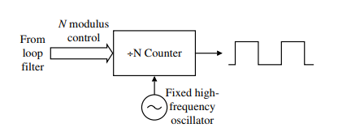
N Divider
High Frequency Dividers
The output of the VCO (id counter) is between 200-2500 MHz. N value is high for the prescaller is used
Low Frequency Dividers
The VCO (ID Counter) output in low frequency splitters has a value range of <100 Mhz and 100 Mhz
Figure.24
There are two types of N divider:
Integer N divider
Fractional N divider.
The main task is to split the signal received from VCO at the specified rate and send it to the phase detection section
21

Slide 22
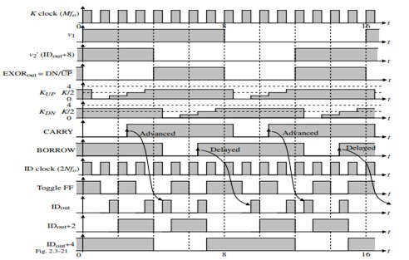
PLL Theory
Figure.25

Slide 23
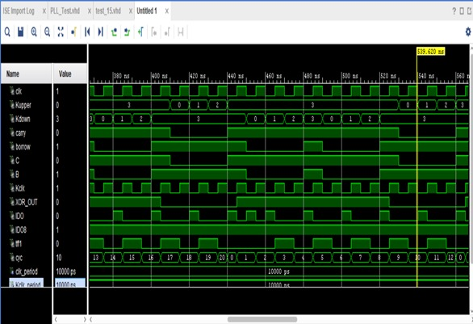
PLL Vivado Simulation
Figure.26

Slide 24
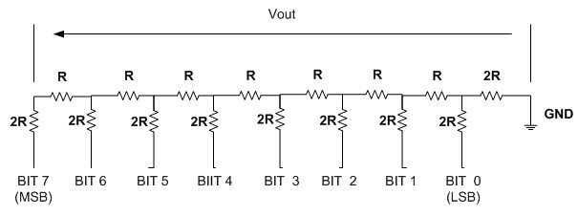
Ladder Circuit Design & Commentary
The ladder Circuit in figure is used as a D/A converter.
Figure.27

Slide 25
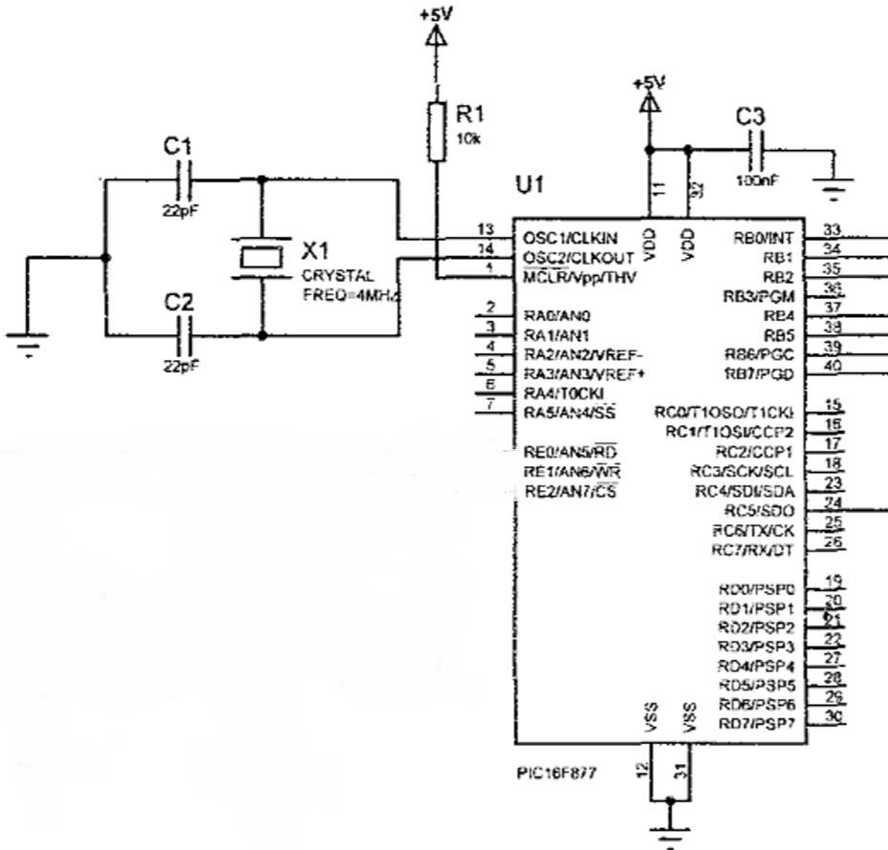
Microprocessor Converter Circuit Design & Commentary
PIC16F877A microprocessor used for analog-digital converter.
AN5 (port-E0 pin) used for analog receiver.
Port-B’s all pins used for digital data transfer.
Microprocessor process the voltage data into digital equvalence of them.
Figure.28

Slide 26
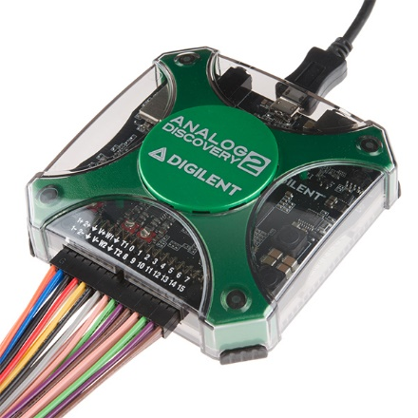
Analog Discovery
Analog Discovery 2 used for two applications,
To feed the microprocessor circuit.
To test the results of digital data transfer via UART.
Figure.29

Slide 27
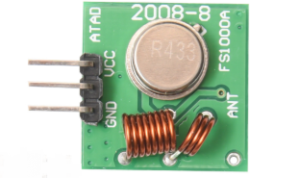
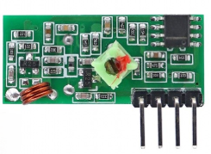
Wireless Unit
Figure.30
Figure.31
Transmitter frequency range 433.92MHz
Transmitter supply voltage 3v~6v
Transmitter output power 4v~12v
Receiver frequency 433MHz
Receiver supply current 3.5mA
Low power consumption
Receiver operating voltage 5v

Slide 28



Economic View

Slide 29
Future Work
4G Hand Devices
5G Communication System
IOT (Internet Of Things) & Smart House
Image & Sound Proccesing
Wireless Communication
Software Application

Slide 30
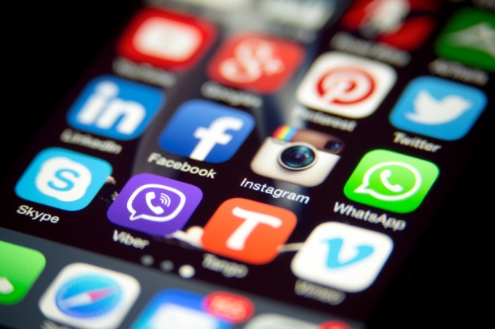
The Software Application
Phone application that can be used for anyone and anywhere in anytime.
With this application people can control the system and access any data they want from the smart system.
Figure.32

Slide 31
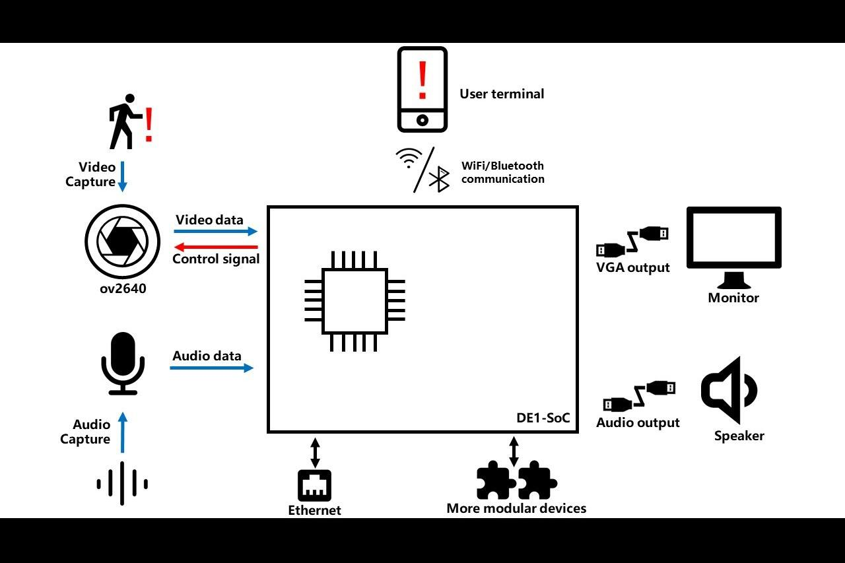
The Software Application
Figure.33

Slide 32
Conclusion
In conclusion, we created a transceiver system that transfers digital data successfully. In cable application current state of system is enough for us. However in wireless applications ADPLL algorithm has to be used for reducing the phase errors of transmitted signal.

Slide 33
References
https://ijarcce.com/wp-content/uploads/2015/01/IJARCCE3J-a-sri-RaghavaKumari-Implementation-of-Embedded-1.pdf
https://www.intel.com/content/www/us/en/products/programmable/topics.html
https://www.rs-online.com/designspark/10-things-you-can-do-with-software-defined-radio
https://www.edgefx.in/fpga-architecture-applications/
https://www.researchgate.net/publication/269327594_FPGAs_in_software_defined_radio
https://www.researchgate.net/publication/224321693_GSM-based_remote_sensing_and_control_system_using_FPGA
http://pallen.ece.gatech.edu/Academic/ECE_6440/Summer_2003/L070-DPLL(2UP).pdf
http://pallen.ece.gatech.edu/Academic/ECE_6440/Summer_2003/L080-ADPLL(2UP).pdf
http://pep.ijieee.org.in/journal_pdf/11-273-147100189377-79.pdf
https://pdfs.semanticscholar.org/fff3/da99b209a00affe5e8b78ec5d14a2a3e2ec0.pf

Slide 34
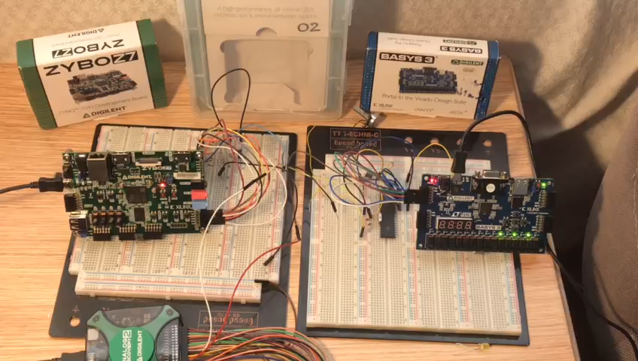

Slide 35


